Slide 1
Object Oriented Programming Paradigm

Slide 2
Shifting to OOP
As procedural programming became more and more mainstream, computer scientists started to notice the issue behind states and side effects.

Slide 3
Shifting to OOP
Some languages offered a complete paradigm shift, completely abandoning the notion of state.
This formed the alternative paradigm family, declarative paradigm.

Slide 4
Shifting to OOP
Other languages however, went on the direction of fixing state by introducing richer features and more intuitive design

Slide 5

Shifting to OOP
From this approach the paradigm object-oriented programming was born.

Slide 6
Issues in Maintainability
As programmers started to build bigger and bigger systems, they started to notice the issues in terms of maintainability.

Slide 7
Issues in Maintainability
Hardware became faster and systems became more complex so the concern shifted from code that runs, to code that was intuitive.

Slide 8
Code that runs
Assembly code was not really built to be intuitive. It was built to reliably work.
Assembly contained mechanisms to move data around and to control program flow.

Slide 9
Code that runs
These features were enough for that time since the goal of programming was to write efficient code that bulky slow CPUs understand.
Notes:
And computers are better at understanding complicated shit like assembly but humans are not

Slide 10
Code that is intuitive
The landscape started to change when hardware started becoming better and software started becoming more complex.

Slide 11
Code that is intuitive
Speed and memory wasn't that much of an issue anymore so computer scientists' focus shifted towards the issue of maintainability.

Slide 12
Code that is intuitive
Software became bigger and more complex and understanding other programmers' code became more and more difficult.
Notes:
In fact, understanding your own code was also becoming difficult

Slide 13
Code that is intuitive
Because of this writing code that a computer understands isn't enough anymore, a good programmer must write code that humans understand as well.
Notes:
In fact, understanding your own code was also becoming difficult

Slide 14
Code that is intuitive
Code shifted from computer centered to human centered.
Notes:
In fact, understanding your own code was also becoming difficult

Slide 15
Staying in the imperative family
But instead of redesigning the concept of imperative paradigm to solve maintainability, object oriented programming sought to build on top of the features of procedural programming.

Slide 16
Staying in the imperative family
State still exists but OOP gave imperative programmers extra tools to protect code from being carelessly mutated.
Notes:
Because of this OOP is still imperative since the programmer is still telling the computer what to do using assignment statements and mutation.

Slide 17
Staying in the imperative family
In the procedural programming paradigm, data and behavior is independent from each other making access to data unaccounted and unpredictable.

Slide 18
Staying in the imperative family
Because of this every piece of data and every piece of behavior become mixed together.
There are no boundaries between irrelevant data.

Slide 19
Fundamental Concepts of OOP
Object oriented programming is usually defined using its three core design principles:
Encapsulation
Abstraction
Inheritance
Polymorphism

Slide 20
Fundamental Concepts
Calling the entirety of a programming language, OOP can be problematic since you are free to write code written in an "OOP language" without actually using these design principles.

Slide 21
Fundamental Concepts
At the end of the day OOP is not a language classification, but a paradigm.
Notes:
Some programming languages are indeed intentionally written to be used for OOP design but these classifications are less important than judging if the code itself written by a programmer adheres to OOP's design principles.

Slide 22
THE OBJECT AND THE CLASS

Slide 23
What exactly is an object?

Slide 24
Object
An object is a living organism in your code.
Treating an object as an organism will guide you on how you use objects effectively.

Slide 25
Object
Just like any creature an object has both form (attributes) and behavior (methods).
Notes:
this is one of the reasons why C's struct is not an object since structs only have form

Slide 26
Object
Objects are written to be representations of real world nouns such as a person or an employee or a file.
Notes:
this is one of the reasons why C's struct is not an object since structs only have form

Slide 27
Object
The best way to design objects is to simulate the real world form and behavior of what these objects represent.
Think of objects as the representatives of things in your code.
Notes:
this is one of the reasons why C's struct is not an object since structs only have form

Slide 28
Class
There's usually a lot of confusion when identifying the difference between a class and an object and it is probably because in the universe of your code, the class and the object will have the same name.

Slide 29
Class
A class is the specifications for the creation of objects.
If you want to give a class a more proactive role, you can think of the class as the factory that builds objects.

Slide 30
Class
a star shaped cookie cutter (class) that makes star shaped cookies (objects). If you want to make star shaped cookies you use the star shaped cookie cutters.

Slide 31
Class
If an object is a representation of a tangible real world object, then the class is the conceptual type/category of that real world object.

Slide 32
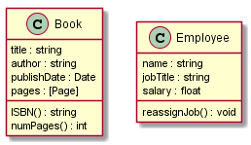

Slide 33
book1{ title: "Corpus Hermeticum" author: "Hermes Trismegistus“ publishDate: Dec 12, 2008 pages: ...... } book2{ title: "Behold a Pale White Horse" author: "Milton William Cooper" publishDate: Dec 1, 1991 pages: ...... }
employee1{ name: "Rubelito Abella" jobTitle: "Instructor 1" salary: [REDACTED] }

Slide 34
The Surface and the Volume

Slide 35
Data Hiding and the Interface
The base premise of OOP is the concept called data hiding.

Slide 36
Data Hiding and the Interface
What OOP did for imperative programming was to allow the programmer to create artificial boundaries between irrelevant data and behavior.

Slide 37
Data Hiding and the Interface
In the eyes of an OOP design, procedural code is a mix of data and functions arbitrarily tossed in a spaghetti of mutations and side-effects.

Slide 38
Data Hiding and the Interface
OOP's mechanism to create boundaries in the form of objects brought structure to imperative programming.

Slide 39
Data Hiding and the Interface
Object oriented programming obsesses over structure and simulation because it is a necessity for human comprehension and therefore, maintainability.

Slide 40
Data Hiding and the Interface
Systems need good structure not because well structured code is pleasant and elegant to look at, but because our feeble minds can't process poor structure efficiently.

Slide 41
Data Hiding and the Interface
The process of modeling elegant object representations is basically determining what the public interface of that object may be.
The interface of an object is the set of attributes and methods that other objects can use to interact with it.

Slide 42
Data Hiding and the Interface
The attributes and methods that are not in the interface are essentially hidden information, inaccessible from the client objects.

Slide 43
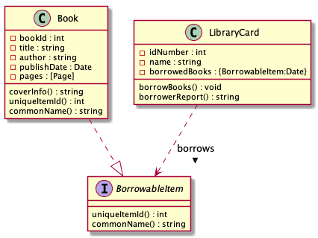

Slide 44
Abstraction of Objects
Creating interfaces like these provide OOP with the mechanism to create abstractions in the object level.

Slide 45
Abstraction of Objects
An abstraction in computer science is basically a model of computation that is free from its implementation.

Slide 46
Abstraction of Objects
In the same way that functional programming creates abstractions of mathematical functions by writing lambdas without side effects, OOP creates abstractions of objects using interfaces that don't specify the exact implementation of an object.

Slide 47
Abstraction of Objects
The reason why this structure still works, is because we have a concrete class called Book which is a realization or an implementation of BorrowableItem.

Slide 48
Abstraction of Objects
Because a Book is a BorrowableItem, it must also behave based on the specifications of a BorrowableItem.
Meaning it must contain the methods uniqueItemId() and commonName()

Slide 49
Abstraction of Objects
Since Book is a concrete class it's methods uniqueItemId() and commonName() should be implemented (meaning there should be code inside these methods).

Slide 50
Why even go through all this trouble?

Slide 51
Abstraction and maintainability
For the current structure we created, this feels like extra code because our system is small enough right now.

Slide 52
Abstraction and maintainability
For the current structure we created, this feels like extra code because our system is small enough right now.
If our system grows and we need to incorporate other things from the library that are not books but can be borrowed.

Slide 53
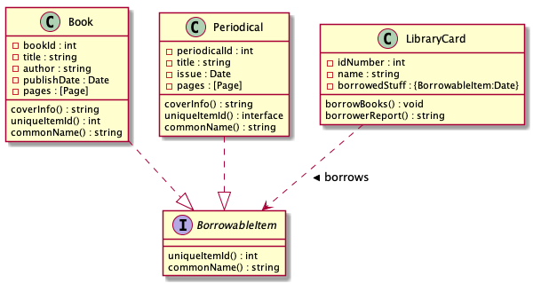

Slide 54
Abstraction and maintainability
You need a different representation for a periodical, therefore you need to create a new concrete class called Periodical.

Slide 55
Abstraction and maintainability
Since a periodical is also something from the library that can be borrowed, a periodical is another realization of BorrowableItem.

Slide 56
Abstraction and maintainability
And with the tiny effort of writing the implementation of a periodical (including the realized methods uniqueItemId() and commonName()), we added an extra interaction that allows a LibraryCard to borrow periodicals as well.

Slide 57
OOP’s Philosophy The Interface and the Implementation
The paradigm's aims to solve the issues of state and maintainability by allowing programmers to create boundaries between its mix of attributes and methods.

Slide 58
OOP’s Philosophy: The Interface and the Implementation
The boundaries you enforce are basically the object structure you create.
A library card name shouldn't mix with a book title so we put a boundary between them by encapsulating them into their respective objects.

Slide 59
OOP’s Philosophy: The Interface and the Implementation
The boundaries you enforce are basically the object structure you create.
A library card name shouldn't mix with a book title so we put a boundary between them by encapsulating them into their respective objects.

Slide 60
OOP’s Philosophy: The Interface and the Implementation
The boundaries you enforce are basically the object structure you create.
A library card name shouldn't mix with a book title so we put a boundary between them by encapsulating them into their respective objects.

